Slide 1
Connecting to a DB

Slide 2
Server Side Connection to a DB
HTML Form gets user input and submits
Script parses the information
User receives information that the script generated
Script establishes DB connection
Script performs activities in DB
Server Side Scripting Lesson
Current Lesson

Slide 3
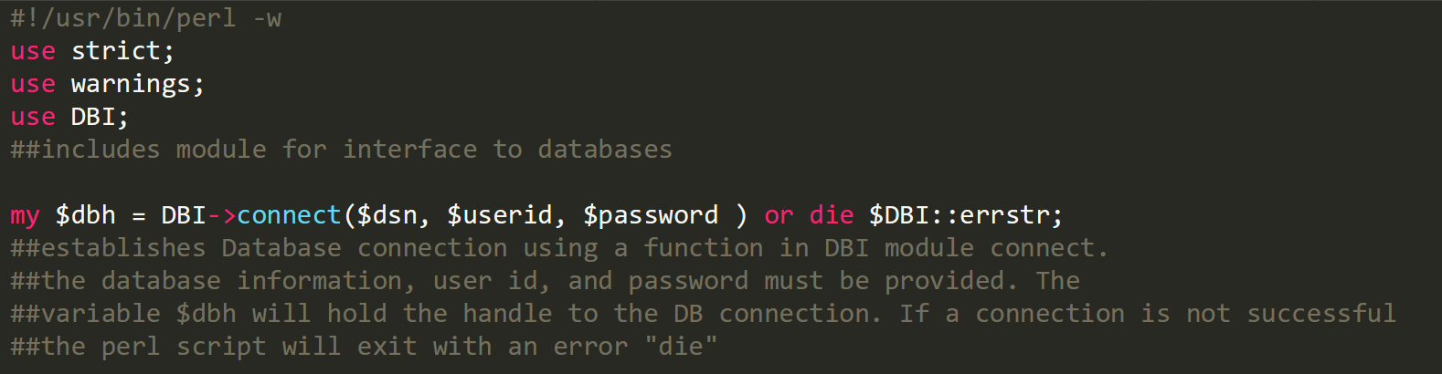
Reminder: How a DB Connection is Established

Slide 4
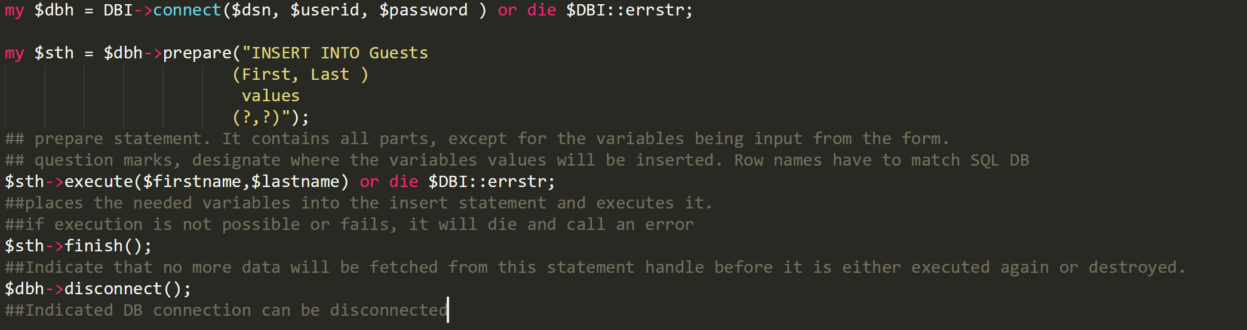
Reminder: Perl Statement Generation

Slide 5
Workflow to Retrieve Data from DB
Establish DB Connection (complete)
Generate an SQL statement (partial)
Process the response from the DB
Post back appropriate results

Slide 6
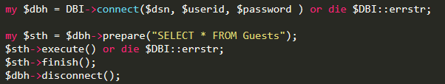
Perl Select Statement Generation
Previous code for insertion of records
Code for retrieving records that have been inserted into table Guests
Should retrieve all records from the
Table Guests

Slide 7
1
Prepare statement to retrieve
all records from the Table Guests
2
Execute statement to retrieve
all records from the Table Guests
3
Indicate that no more data will be fetched
from this statement handle before it is
either executed again or destroyed.
2.5
Data from statement handler needs to be processed in PERL!

Slide 8
Perl Processing Database Response
The statement handler has several attributes and methods
Some important ones for receiving data are:
Fetchrow()
Fetches the next row of results for processing
Row()
Provides number of rows in the response
NUM_OF_FIELDS
Provides number of columns in the response

Slide 9
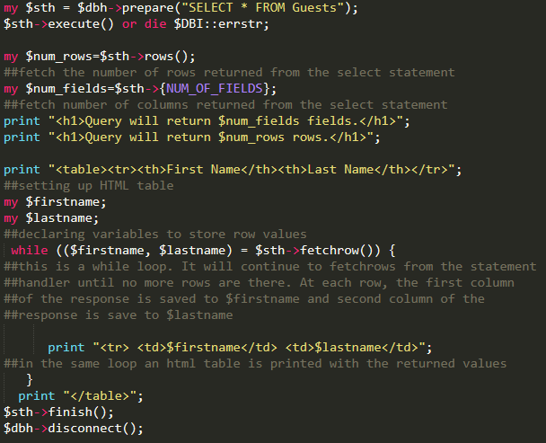
Perl Example

Slide 10
DIY
Take the Perl file select_from.pl and adjust the database connection details to those from last class (if needed correct table name as well)
Make an empty HTML page with one submit button with an “action” attribute set to select_from.pl
Observe! You should see a list of all guests that have their names in the DB
If you have “stubborn” web page, which refused to appear in your web page, then it “cashed”. To fix that in PC: Ctrl_F5; in MAC: Command_Shift_R.

Slide 11
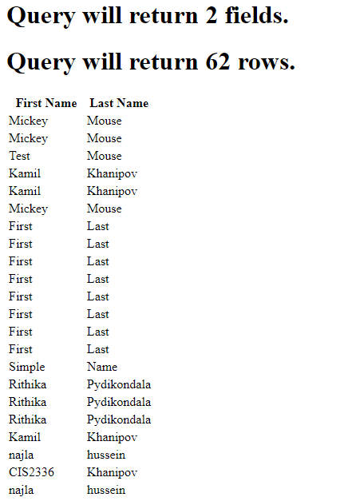
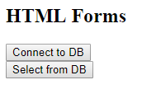
Example: Demo

Slide 12
Customization of Select Statement
Same as with insert statements we can customize Select statements based on input from an HTML form
For example, expand previous example searching for guests by first name instead of listing all of them. Whats needed?
HTML Form with input field and submit button
Perl script
Get input field value from HTML form using param() function
Establish DB connection
Generate Select statement
Execute Select statement (inserting variables for first name)
Process and output results of select statement

Slide 13
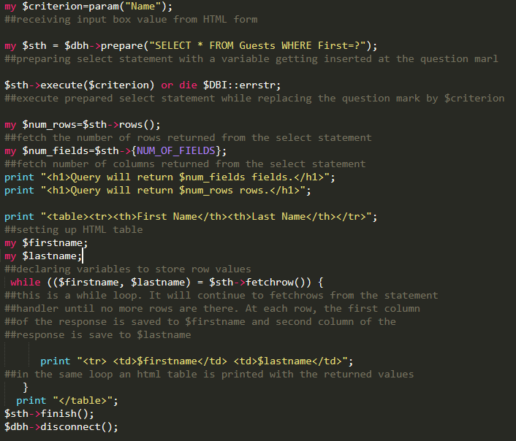
Adding functionality to Perl Script

Slide 14
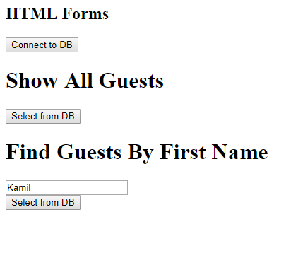
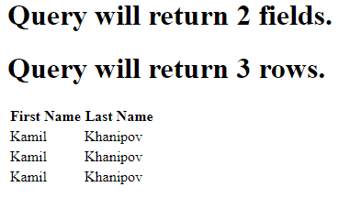
Example: Demo

Slide 15
DIY: Make the Jump
Start with form_extended.html and the DB you created last week for it
Populate the DB with 5-10 entries.
Add an additional form in the html file with an input field that submits to a new Perl Script.
Have the new Perl Script process the input field based on first name, and generate a “SELECT FROM WHERE” statement, and process it.
Try various search queries.
Submit your code, screenshot of DB, and HTML page output.
Extra thought: Check number of rows returned from statement handler, if nothing is returned you could display an error message.

